Slide 1
Factors Affecting First Generation and Non-First Generation College Students During COVID-19
Susan Sonnenschein, Jane H. Nam, Sarah R. Turner, Samantha H. Galczyk, & Diane C. Placide
University of Maryland, Baltimore County
In symposium, C.R. Starr (Chair) First Generation Students’ Strengths to Promote Academic and STEM Motivation. SRA, New Orleans, March 2022.

Slide 2
Purpose
To consider factors that promote First Generation and Non-First Generation college students’ academic success during the COVID-19 pandemic.

Slide 3
Theoretical Framework
Bronfenbrenner & Morris (2006) ecological model
Byrnes and Miller (2007) (antecedent) opportunity propensity framework
Cabrera (2013) strength-based approach

Slide 4
Background
First Generation College Students
Increasing percentage of college population is first generation (firstgen.naspa.org)
Demographic group (Lederer et al., 2021; Redford & Hoyer, 2017)
Financial stressors (firstgen.naspa.org)
Difficulty navigating college requirements (firstgen.naspa.org; resilienteducator.com)
Less likely graduate in 5 years
Less likely to seek out support

Slide 5
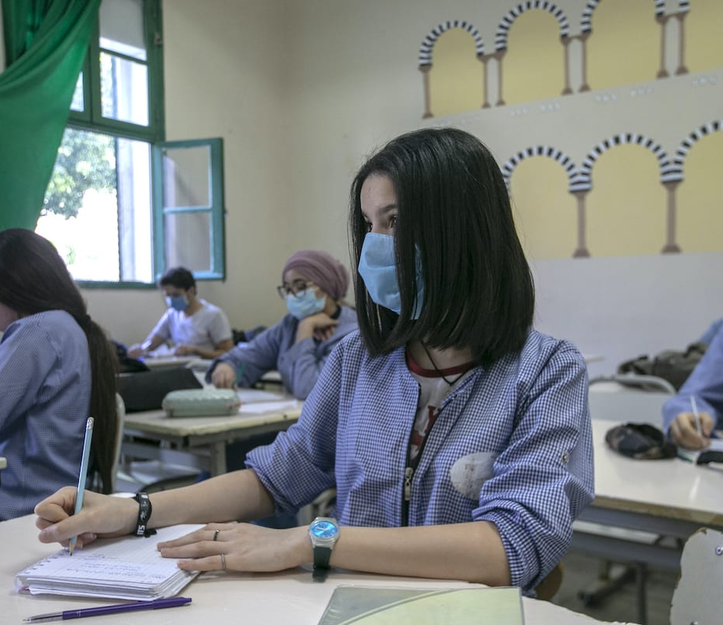
COVID-19
Lederer et al. (2021) argues that COVID-19 has compounded stressors on college students, particularly those already placed at risk due to demographic characteristics

Slide 6
This Study
Compared First Generation and Non-First Generation students attending a mid-size, middle-Atlantic university during COVID-19 in Fall 2020
Research Questions:
What factors promote academic success for each group, and do they differ?
What factors interfere with academic success for each group, and do they differ?

Slide 7
Method
Participants
First Generation Students (N=126)
African American/Latinx (N=29; 23%)
White/Asian (N=82; 65%)
Non-First Generation Students (N=304)
African American/Latinx (N=34; 12%)
White/Asian (N=216; 71%)

Slide 8
Method Continued
Procedure
Asked to complete online survey
Measures
Online Student Engagement (OSE, Dixson, 2015)
Academic Motivation Scale (AMS-C28,Vallerand et al., 1992)
Supportive Friends, Professors & Home
School Support
Technology
Mental Health
Financial Stress
GPA

Slide 9
Results
No Differences by Gender or Class year
Covariates: Race/Ethnicity & Income
Conducted a moderation model
Findings:
GPA did not differ between the groups
First-Generation status did not moderate the relation between predictors and GPA
For both groups of students,
Academic motivation and online student engagement significantly predicted GPA (p<.05 respectively)
Financial stress significantly predicted GPA (p<.05)

Slide 10
Results Continued
Significant differences between First Generation and Non-First Generation (p < .05):
Academic Motivation: First Generation > Non-First Generation
Online Student Engagement: First Generation > Non-First Generation
Financial Stress: First Generation > Non-First Generation
Home Environment: First Generation < Non-First Generation
Technology: First Generation < Non-First Generation

Slide 11
Discussion/Conclusion
Factors impacting students’ GPA were academic motivation, online student engagement, & financial stress during COVID-19
Did not differ between First Generation & Non-First Generation students
However, the levels of factors did:
Motivation and engagement were promotive factors and higher for First Generation students
Financial Stress was an impediment and was higher for First Generation students
Technology and Home Support were greater issues for First Generation students
What can we do?

Slide 12
Thank you! Questions?
Contact:
Susan Sonnenschein
sonnensc@umbc.edu
Sonnenschein Lab
sonnenscheinlab.umbc.edu

